Slide 1


NoSQL Databases
Department of Computer Science Engineering
School of Engineering

Slide 2
Module 1 : NoSQL Database Architectures
Transactions: Concurrency and Integration, ACID, NoSQL emergence and its main features, BASE for reliable database transactions, Achieving horizontal scalability with database sharding, Brewers CAP theorem. Main Data models of NoSQL: Document Data Model, Key-Value Data Model, Columnar Data Model, Graph Data Model.
[6Hrs.] [Knowledge]

Slide 3
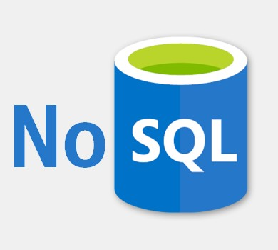
Introduction
What is NoSQL?
NoSQL is a database store that does not require table-based relational models to hold structured, unstructured, and semi-structured data.
Types of NoSQL Databases:
Key Valued Storage
Document Storage
Column Storage
Graph Storage

Slide 4
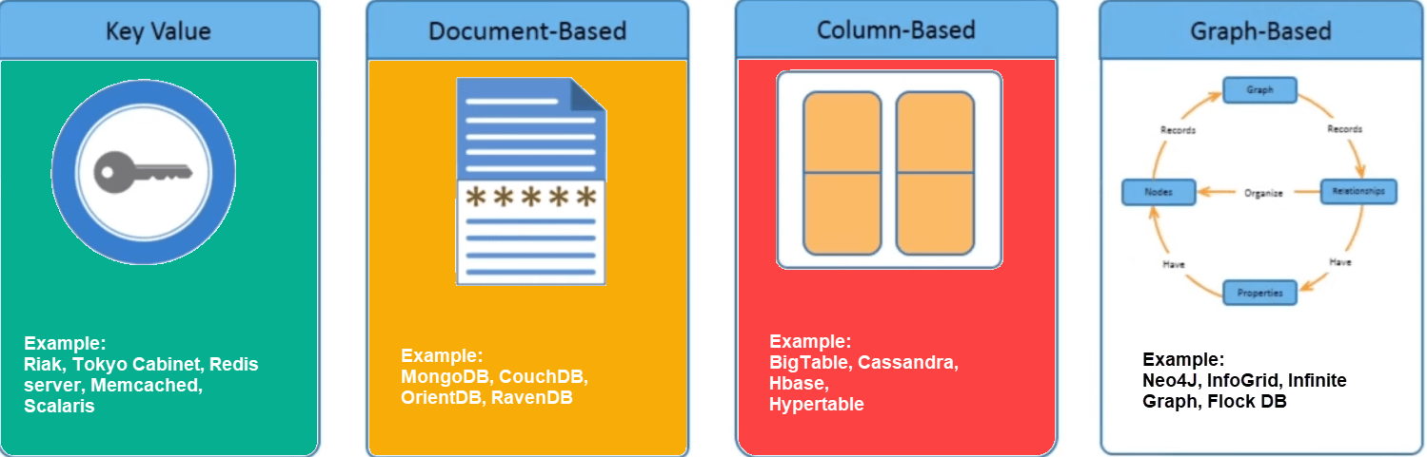
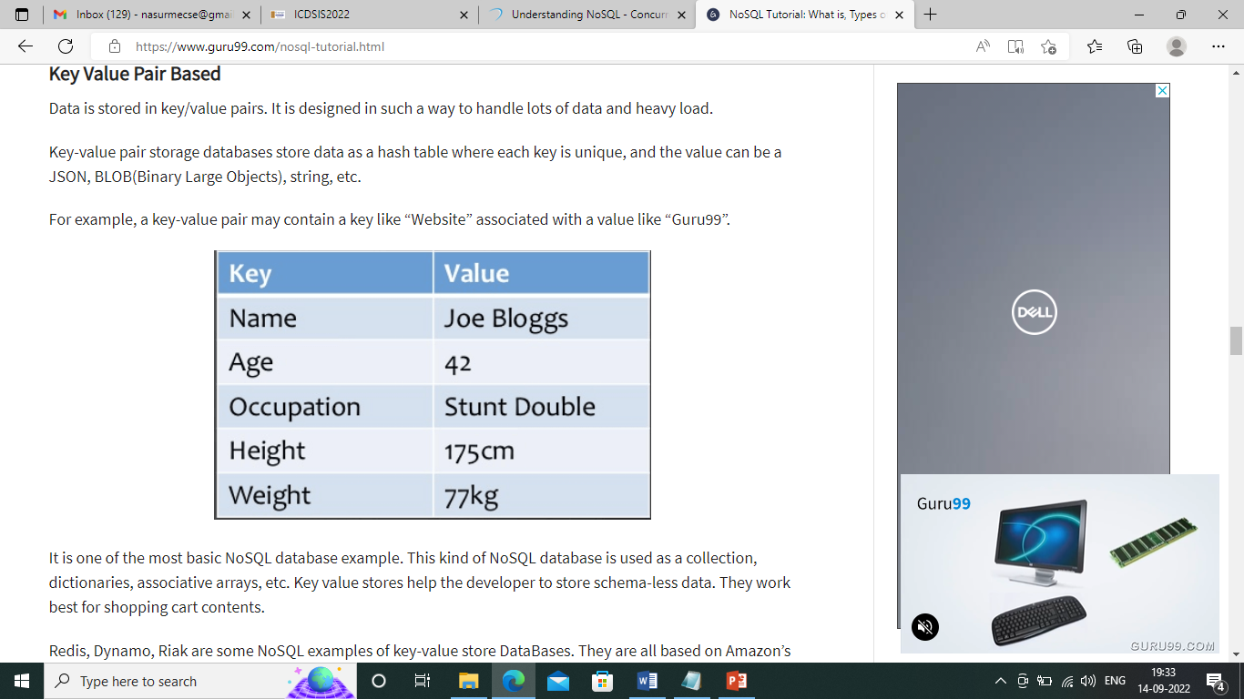
Key Value Pair Based
Data is stored in key/value pairs. It is designed in such a way to handle lots of data and heavy load.
Key-value pair storage databases store data as a hash table where each key is unique, and the value can be a JSON, BLOB(Binary Large Objects), string, etc.

Slide 5
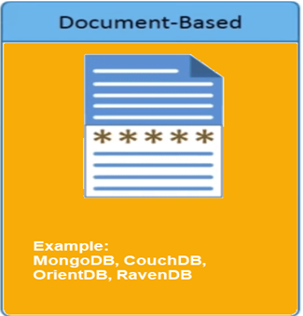
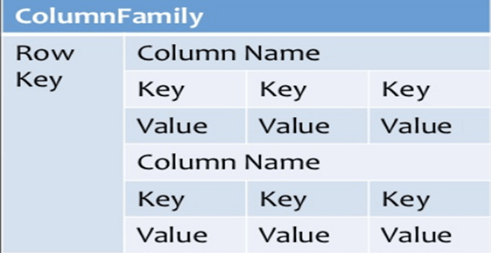
Column-based
Column-oriented databases work on columns and are based on BigTable paper by Google. Every column is treated separately. Values of single-column databases are stored contiguously.
Column-based NoSQL databases are widely used to manage data warehouses, business intelligence, CRM, and Library card catalogs.

Slide 6
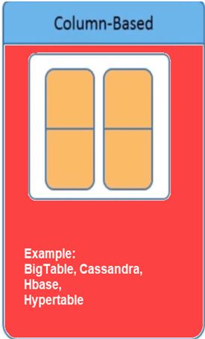
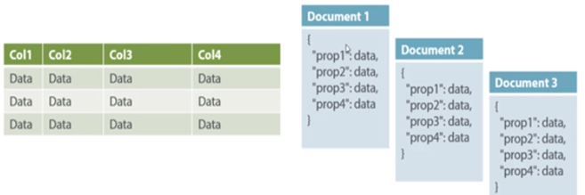
Document-Oriented:
Document-Oriented NoSQL DB stores and retrieves data as a key value pair but the value part is stored as a document. The document is stored in JSON or XML formats. The value is understood by the DB and can be queried.

Slide 7
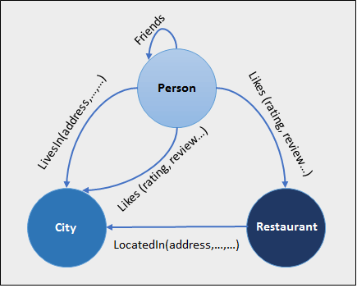
Graph Based
A graph-type database stores entities as well the relations amongst those entities. The entity is stored as a node with the relationship as edges. An edge gives a relationship between nodes. Every node and edge has a unique identifier.
Graph base database mostly used for social networks, logistics, spatial data.

Slide 8
Concurrency and Integration
Concurrency Control in Database Management System is a procedure of managing simultaneous operations without conflicting with each other. It ensures that Database transactions are performed concurrently and accurately to produce correct results without violating the data integrity of the respective Database.
Database integration is the process used to aggregate information from multiple sources—like social media, sensor data from IoT, data warehouses, customer transactions, and more—and share a current, clean version of it across an organization.

Slide 9
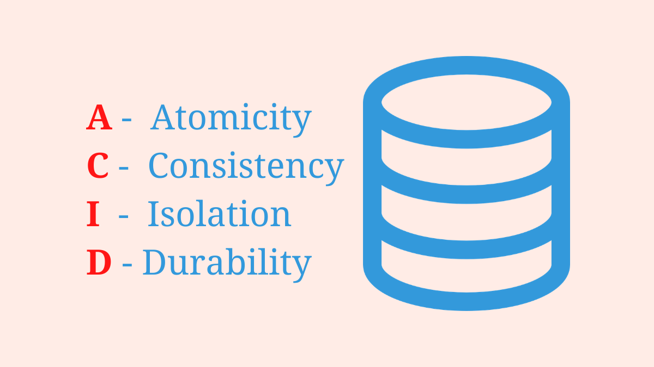
ACID
ACID Properties are used for maintaining the integrity of the database during transaction processing.
The ACID in DBMS stands for Atomicity, Consistency, Isolation, and Durability.

Slide 10
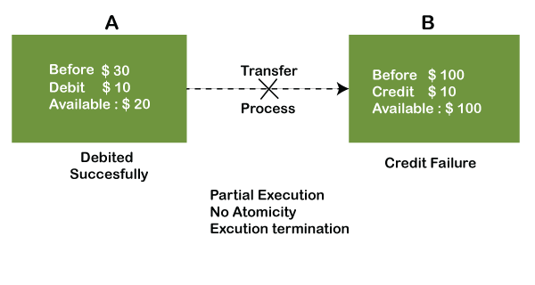
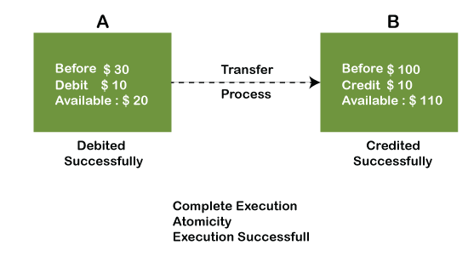
A- Atomicity
The Entire transaction takes place at once. (i.e) Atomicity: A transaction is a single unit of operation.

Slide 11
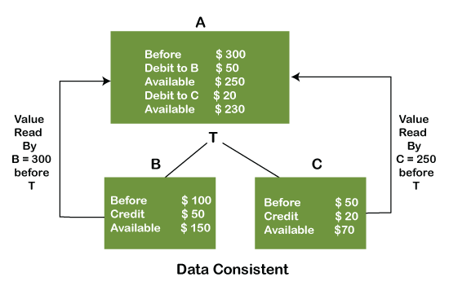
C- Consistency
The database must be consistent before and after the transaction.
The word consistency means that the value should remain preserved always.

Slide 12
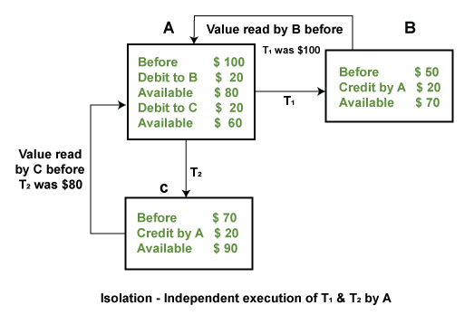
I- Isolation
Multiple Transactions occur independently without interference.
The term 'isolation' means separation.

Slide 13
D - Durability
The Changes in successful transactions occur even if the system failure occurs.
Durability ensures the permanency of something.
Therefore, the ACID property of DBMS plays a vital role in maintaining the consistency and availability of data in the database.

Slide 14
Why NoSQL? And History
The concept of NoSQL databases became popular with Internet giants like Google, Facebook, Amazon, etc. who deal with huge volumes of data. The system response time becomes slow when you use RDBMS for massive volumes of data.​
To resolve this problem, we could “scale up” our systems by upgrading our existing hardware. This process is expensive.​
The alternative for this issue is to distribute database load on multiple hosts whenever the load increases. This method is known as “scaling out.”​
NoSQL database is non-relational, so it scales out better than relational databases as they are designed with web applications in mind.​

Slide 15
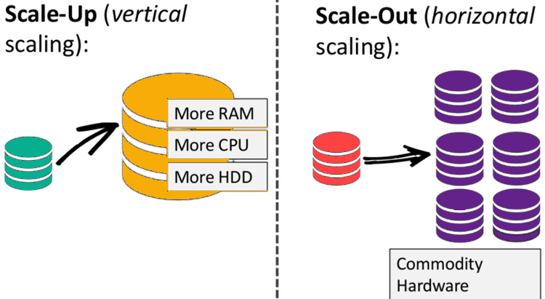
Why NoSQL? And History

Slide 16
Why NoSQL? And History
1998- Carlo Strozzi use the term NoSQL for his lightweight, open-source relational database
2000- Graph database Neo4j is launched
2004- Google BigTable is launched
2005- CouchDB is launched
2007- The research paper on Amazon Dynamo is released
2008- Facebooks open sources the Cassandra project
2009- The term NoSQL was reintroduced

Slide 17
Features of NoSQL
Non-relational
NoSQL databases never follow the relational model
Never provide tables with flat fixed-column records
Work with self-contained aggregates or BLOBs
Doesn’t require object-relational mapping and data normalization
No complex features like query languages, query planners, referential integrity join, ACID

Slide 18
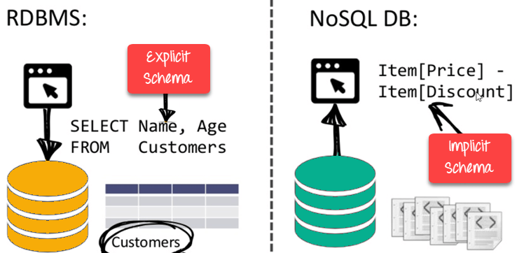
Features of NoSQL
Schema-free
NoSQL databases are either schema-free or have relaxed schemas
Do not require any sort of definition of the schema of the data
Offers heterogeneous structures of data in the same domain

Slide 19
Features of NoSQL
Simple API
Offer easy-to-use interfaces for storage and querying data provided
APIs allow low-level data manipulation & selection methods
Text-based protocol mostly used with HTTP REST with JSON
Mostly used no standard based NoSQL query language
Web-enabled databases running as internet-facing services

Slide 20
Features of NoSQL
Distributed
Multiple NoSQL databases can be executed in a distributed fashion
Offers auto-scaling and fail-over capabilities
Often ACID concept can be sacrificed for scalability and throughput
Mostly no synchronous replication between distributed nodes Asynchronous Multi-Master Replication, peer-to-peer, HDFS Replication
Only providing eventual consistency
Shared Nothing Architecture. This enables less coordination and higher distribution.

Slide 21
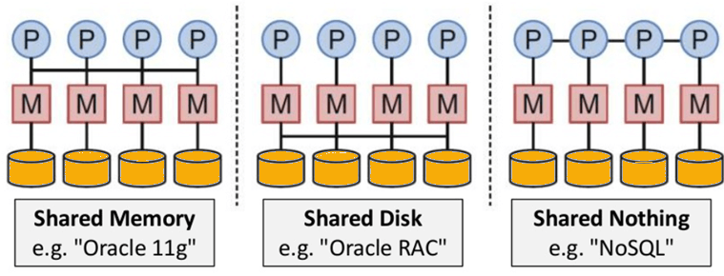
Features of NoSQL
Distributed

Slide 22
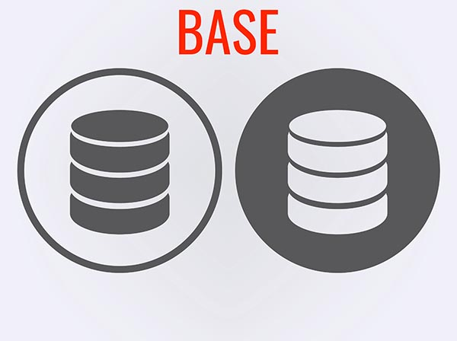
BASE - Basically Available, Soft state, Eventual consistency
Definition: An alternative to the ACID data processing model.
The ACID model provides a consistent system.
The BASE model provides high availability.
Basically, available means DB is available all the time as per CAP theorem
Soft state means even without input; the system state may change
Eventual consistency means that the system will become consistent over time.
Example :
Using shopping cart applications on a website.
Monitoring network and IT infrastructure security
Managing and reusing document content

Slide 23
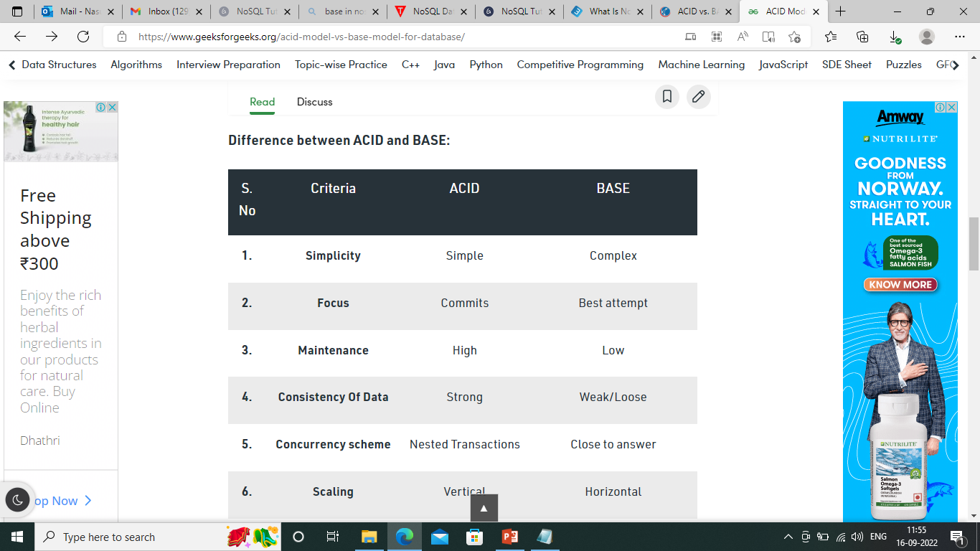
ACID Vs BASE

Slide 24
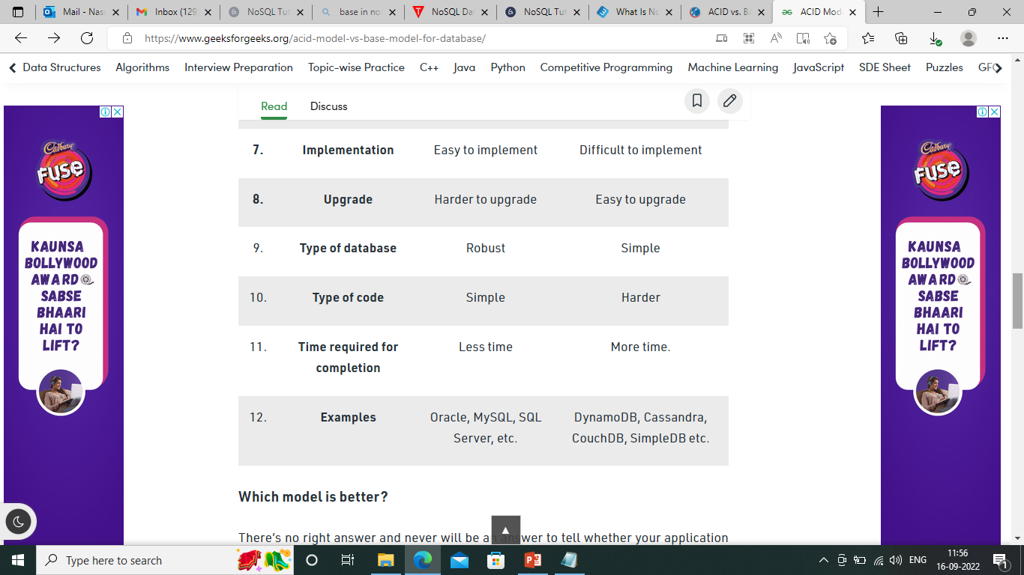
ACID Vs BASE

Slide 25
ACID Vs BASE
ACID-compliant databases will be a better fit for those who require consistency, predictability, and reliability.
BASE model, because it enables easier scaling up and provides more flexibility.
Databases: Just as SQL databases are almost uniformly ACID compliant, NoSQL databases tend to conform to BASE principles. MongoDB, Cassandra, and Redis are among the most popular NoSQL solutions, together with Amazon DynamoDB and Couchbase.
(i.e) The term “eventual consistency” means to have copies of data on multiple machines to get high availability and scalability.

Slide 26
CAP – Consistency , Availability, Partition Tolerance
CAP Theorem: The CAP theorem is also called the brewer’s theorem. It states that is impossible for a distributed data store to offer more than two out of three guarantees:
Consistency
Availability
Partition Tolerance
Consistency :
The data should remain consistent even after the execution of an operation. This means once data is written, any future read request should contain that data.
For example, after updating the order status, all the clients should be able to see the same data.

Slide 27
CAP – Consistency , Availability, Partition Tolerance
Availability: The database should always be available and responsive. It should not have any downtime.
Partition Tolerance: Partition Tolerance means that the system should continue to function even if the communication among the servers is not stable.
For example, the servers can be partitioned into multiple groups which may not communicate with each other. Here, if part of the database is unavailable, other parts are always unaffected.

Slide 28
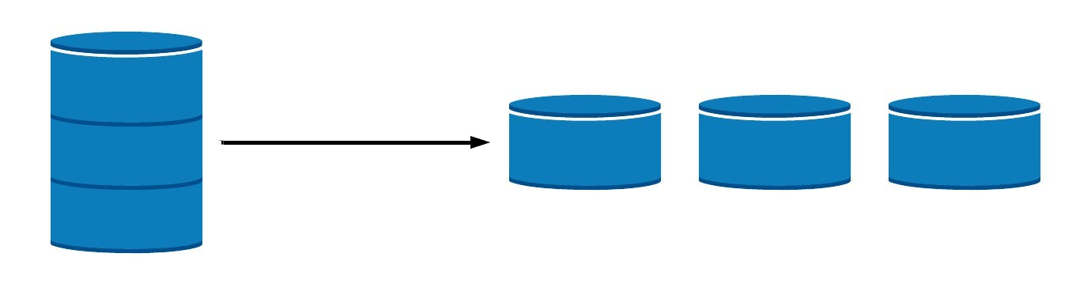
Database Sharding
Sharding is a method for distributing a single dataset across multiple databases, which can then be stored on multiple machines.
Sharding is a form of scaling known as horizontal scaling or scale-out.
Horizontal scaling allows for near-limitless scalability to handle big data and intense workloads.
vertical scaling refers to increasing the power of a single machine or single server through a more powerful CPU, increased RAM, or increased storage capacity.

Slide 29
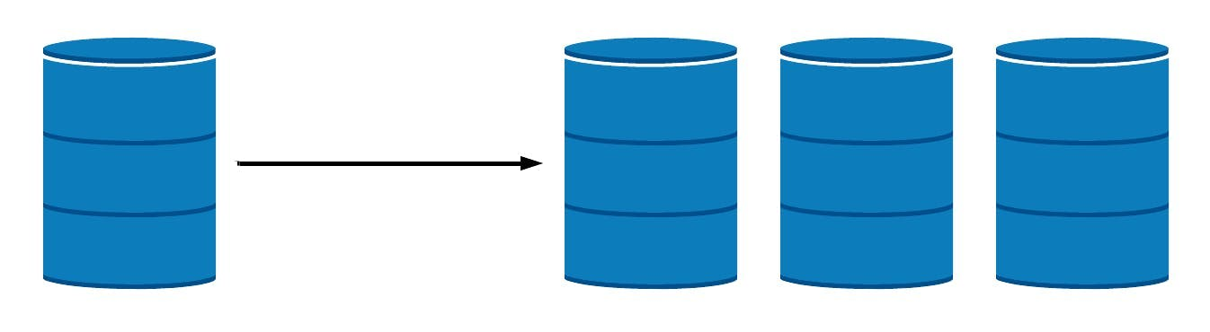
Replication
If your data workload is primarily read-focused, replication increases availability and read performance while avoiding some of the complexity of database sharding.

Slide 30
Advantages of Sharding
Sharding allows you to scale your database to handle the increased load to a nearly unlimited degree by providing increased read/write throughput, storage capacity, and high availability.
Increased read/write throughput: distributing the dataset across multiple shards, both read and write.
Increased storage capacity: By increasing the number of shards, you can also increase overall total storage capacity, allowing near-infinite scalability.
High availability: shards provide high availability in two ways. First, since each shard is a replica set, every piece of data is replicated. Second, even if an entire shard becomes unavailable since the data is distributed, the database as a whole still remains partially functional, with part of the schema on different shards.

Slide 31
Disadvantages of Sharding
Sharding does come with several drawbacks, namely overhead in query result compilation, the complexity of administration, and increased infrastructure costs.
Query overhead — Each sharded database must have a separate machine or service which understands how to route a querying operation to the appropriate shard. This introduces additional latency in every operation.
The complexity of administration — With a single unsharded database, only the database server itself requires upkeep and maintenance. (i.e) in cases where replication is being used, any data updates must be mirrored across each replicated node.
Increased infrastructure costs — Sharding by its nature requires additional machines and compute power over a single database server

Slide 32
Advantages of NoSQL
Can be used as a Primary or Analytic Data Source
Big Data Capability
No Single Point of Failure
Easy Replication
No Need for Separate Caching Layer
It provides fast performance and horizontal scalability.
Can handle structured, semi-structured, and unstructured data with equal effect
Object-oriented programming which is easy to use and flexible
NoSQL databases don’t need a dedicated high-performance server

Slide 33
Advantages of NoSQL
Support Key Developer Languages and Platforms
Simple to implement than using RDBMS
It can serve as the primary data source for online applications.
Handles big data which manages data velocity, variety, volume, and complexity
Excels at distributed database and multi-data centre operations
Eliminates the need for a specific caching layer to store data
Offers a flexible schema design that can easily be altered without downtime or service disruption

Slide 34
Disadvantages of NoSQL
No standardization rules
Limited query capabilities
RDBMS databases and tools are comparatively mature
It does not offer any traditional database capabilities, like consistency when multiple transactions are performed simultaneously.
When the volume of data increases it is difficult to maintain unique values as keys become difficult
Doesn’t work as well with relational data
The learning curve is stiff for new developers
Open source options so not so popular for enterprises.

Slide 35
Summary of NoSQL
NoSQL is a non-relational DMS, that does not require a fixed schema, avoids joins, and is easy to scale
The concept of NoSQL databases became popular with Internet giants like Google, Facebook, Amazon, etc. who deal with huge volumes of data
In the year 1998- Carlo Strozzi use the term NoSQL for his lightweight, open-source relational database
NoSQL databases never follow the relational model it is either schema-free or has relaxed schemas
Four types of NoSQL Database are 1). Key-value Pair Based 2). Column-oriented Graph 3). Graphs based 4). Document-oriented

Slide 36
Summary of NoSQL
NoSQL can handle structured, semi-structured, and unstructured data with equal effect
CAP theorem consists of three words Consistency, Availability, and Partition Tolerance
The BASE stands for Basically Available, Soft state, Eventual consistency
The term “eventual consistency” means to have copies of data on multiple machines to get high availability and scalability
NoSQL offer limited query capabilities

Slide 37


